Slide 1

Project Report
on Community Internship
AUDISANKARA COLLEGE OF ENGINEERING & TECHNOLOGY
(Accredited by NBA & NAAC A+)
DEPARTMENT OF COMPUTER SCIENCE AND ENGINEERING (DATA SCIENCE)

Slide 2

(Accredited by NBA & NACC A+) GUDUR, TIRUPATI (DT), A.P, INDIA
DEPARTMENT OF COMPUTER SCIENCE & ENGINEERING
DIGITAL REHABILITATION CENTERS
IN
GUDUR,TIRUPATI (DIST)
A Project work Report submitted to the Jawaharlal Nehru Technological University in a Partial fulfilment for the award of the degree.
BACHELOR OF TECHNOLOGY IN
COMPUTER SCIENCE & ENGINEERING
Submitted by ALAMPOOR THARUN SINGH
Under the esteemed supervision of
Dr. S.V. PADMAVATHI DEVI Ph.D
DEPARTMENT OF COMPUTER SCIENCE AND ENGINEERING AUDISANKARA COLLEGE OF ENGINEERING &TECHNOLOGY (AUTONOMOUS)
(Accredited by NBA &NAAC A+)
Approved by AICTE, Affiliated to JNTUA Anantapuramu, Tirupati (DT), Andhra Pradesh.
(2022-2026)

Slide 3

(Accredited by NBA &NAAC A+)
Approved by AICTE, Affiliated to JNTUA Anantapuramu,
NH-5 Bypass Road, Gudur – 524101, Tirupati (DT), Andhra Pradesh.
Department of Computer Science and Engineering (DS)
CERTIFICATE
This is to certify that the Community Internship Project entitled DIGITAL REHABILITATION CENTERS is the bonafide work done by ALAMPOOR THARUN SINGH in a partial fulfillment of the requirements for the award of the degree of BACHELOR OF TECHNOLOGY in COMPUTER SCIENCE AND ENGINEERING (DATA SCIENCE), from the Jawaharlal Nehru Technological University Anantapuramu, during the year of 2022-2026
Supervisor | Head of the Department | Dean Academics
Dr.S.V.PADMAVATHI DEVI(Ph.d), | Mr. P.V.R.K.MURTY,M.Tech,Ph.D., | Dr. M.RAJAIAH,Ph.D.,
Associate Professor, Associate Professor, Department of CSE,
Department of CAI, | Department of CSD, | ASCET, GUDUR.
ASCET,GUDUR. | ASCET, GUDUR.
DEPARTMENT OF COMPUTER SCIENCE AND ENGINEERING (DATA SCIENCE)

Slide 4
(Accredited by NBA &NAAC A+)
Approved by AICTE, Affiliated to JNTUA Anantapuramu,
NH-5 Bypass Road, Gudur – 524101, Tirupati (DT), Andhra Pradesh.
Department of Computer Science and Engineering
DECLARATION
I, ALAMPOOR THARUN SINGH hereby declare that the Community Project report entitled DIGITAL REHABILITATION CENTERS done under the esteemed guidance of Dr. S.V. PADMAVATHI DEVI Department of Computer Science & Engineering and is submitted in the partial fulfillment of the requirements for the award of the Bachelor Degree in Computer Science and Engineering (Data Science). I have not copied from any other student work or from any other sources except where due reference or acknowledgement is made explicitly, not has any part been authored person. I, as a candidate, declare that in the case of any violation of intellectual property right or copyright will be fully responsible for the same. My supervisor should not be held responsible for full or partial violation of copyright or intellectual property right.
Date:
Place:
PROJECT ASSOCIATE
ALAMPOOR THARUN SINGH
22G21A3202

Slide 5
Table Of Contents
S.No. | Title | Pg. No.
1 | Community Internship Report | 1-2
2 | Student declaration | 2-3
3 | Official Community Certificate | 3-4
4 | Acknowledgments | 4-5
5 | Executive Summary | 5-6
6 | Overview of the Community | 6-7
7 | Community Service part | 7-8
8 | Week wise Activity Logs & Reports | 9-24
9 | Outcomes | 24-25
10 | Identified Problems | 25-26
11 | Plan of Action | 26-27
12 | Description of Awareness Program Conducted | 27-28
13 | Report of Project work | 28-29
14 | Conclusion | 29-30
15 | Evaluation forms | 31-32
16 | Photographs Of Proof | 33-34
DEPARTMENT OF COMPUTER SCIENCE AND ENGINEERING (DATA SCIENCE)

Slide 6
Community Internship Report
Name of the Student: ALAMPOOR THARUN SINGH
Name of the college: AUDISANKARA COLLEGE OF ENGINEERING & TECHNOLOGY
Registration Number: 22G21A3202 Period of CSI: 8 WEEKS
From:23-07-2024 To: 17-09-2024
Name & Address of the Community/Habitation: DIGITAL REHABILITATION CENTERS
GUDUR,TIRUPATI (DIST).
1

Slide 7
Community Internship Report
Submitted in accordance with the requirement for the degree of COMPUTER SCIENCE &
ENGINEERING(DATA SCIENCE)
Name Of the College: AUDISANKARA COLLEGE OF ENGINEERING & TECHNOLOGY
Department: COMPUTER SCIENCE & ENGINEERING (DATA SCIENCE)
Name of the Faculty Guide: Dr. S.V. PADMAVATHI DEVI
Duration of the CSI: 8 WEEKS
From: 23-07-2024 To: 17-09-2024
Name of the Student: ALAMPOOR THARUN SINGH
Programme of Study: BACHELOR OF TECHNOLOGY
Year of Study: III YEAR
Register Number:22G21A3202 Date of Submission:04-10-2024
2
DEPARTMENT OF COMPUTER SCIENCE AND ENGINEERING (DATA SCIENCE)

Slide 8
Student’s Declaration
I,ALAMPOOR THARUN SINGH a student of Community Service Internship Program, Reg.No 22G21A3202 of Department of CSE(DS), Audisankara College of Engineering & Technology do hereby declare that I have completed the mandatory Community Service from 23-07-2024 to 17-09-2024 in GUDUR,TIRUPATI [D.T] under the Faculty Guideship of Mrs.S.V.PADMAVATHI DEVI, Dept of CAI in Audisankara College of engineering & Technology.
(Signature and Date)
Endorsements
Faculty Guide HOD Dean Academics
Dr. S.V.PADMAVATHI DEVI,(Ph.D), Mr P.V.R.K.MURTY ,M.Tech.Ph.D , Dr.M.RAJAIAH,Ph.D.,
Associate professor | Associate Professor, | Department of CSE,
Department of CAI, | Department of CSD, | ASCET, GUDUR.
ASCET,GUDUR. | ASCET, GUDUR.
3

Slide 9
Certificate from Official of the Community
This is to certify that ALAMPOOR THARUN SINGH Reg. No 22G21A3202 of AUDISANKARA COLLEGE OF ENGINEERING & TECHNOLOGY underwent community service in DIGITAL REHABILITATION CENTERS in GUDUR from 23-07-2024 to 17-09-2024.
The overall performance of the Community Service Volunteer during his/her community service is found to be GOOD.
Authorized Signatory with Date and Seal
4

Slide 10
ACKNOWLEDGEMENTS
First and foremost, I would like to express my heartful gratitude to our honorable chairman Dr. VANKI PENCHALAIAH, M.A., M.L., Ph.D., who provided all facilities and necessary encouragement during the course of study.
I would like to thank AUDISANKARA COLLEGE OF ENGINEERING AND TECHNOLOGY providing the extraordinary support in the completion of the project by utilizing the laboratories, library and Software’s required for our project.
I extend my gratitude and sincere thanks to our beloved Director Prof.Dr.J. RAJA MURUGADOSS JEYARAJU Ph.D, Dean Academics Prof. Dr. M. RAJAIAH,Ph.D.,and Principal Prof. Dr. J.RAJA MURUGADOSS JEYA RAJU Ph.D for motivating and providing necessary infrastructure and permitting me to completion of the project.
I would like to express the sense of gratitude towards our Head of the Department Prof. Mr. PVRK MURTHY MTech. Ph.D., and our external guide Dr. S.V.PADMAVATHI DEVI(Ph.D), for their valuable inputs, able guidance, encouragement, whole-hearted cooperation and constructive criticism throughout the duration of our project.
Last, but not the least, I would like to thank my team members, my friends and my
for supporting me in all the aspects for the completion of this project.
parents
Project Associate:
ALAMPOOR THARUN SINGH
5

Slide 11
CHAPTER 1: EXECUTIVE SUMMARY
Android, the leading mobile operating system globally, is used by a diverse range of people for various purposes. This summary examines how different demographics utilize Android phones, highlighting Key usage patterns, preferences.
In today's interconnected world, Android phones have become indispensable tools not only for personal communication and entertainment but also for community service and social impact. These devices, powered by the Android operating system, have democratized access to information, resources, and networks.
Understanding these patterns highlights the significant role of Android technology in fostering community engagement and support, showcasing its potential to enhance social connectivity and collective well-being. Empowering individuals from diverse backgrounds to engage in meaningful acts of service within their communities.
Importance of Android Phones in Community Service
Accessibility: Android smartphones are widely accessible across different socioeconomic strata, offering a range of affordable options that cater to diverse budgets. This accessibility ensures that community service opportunities can be accessed by a broad spectrum of individuals, irrespective of their financial means.
Versatility: The versatility of Android phones allows users to access a wide range of applications and services tailored to various aspects of community service. From communication and organization to fundraising and advocacy, Android apps offer diverse functionalities that support different forms of community engagement.
Connectivity: Android phones facilitate seamless communication and collaboration, enabling individuals to coordinate volunteer efforts, share information, and mobilize resources within their communities. Social media platforms, messaging apps, and collaborative tools empower users to connect with like-minded individuals and organizations, amplifying the impact of their collective efforts.
Information Access: Android devices provide instant access to information and resources relevant to community service initiatives. Users can leverage search engines, news apps, and educational resources to stay informed about local issues, volunteer opportunities, and social causes, empowering them to make informed decisions and take meaningful action.
Digital Innovation: Android technology continues to drive digital innovation in the realm of community service, with developers creating new apps and solutions to address emerging challenges and opportunities. From crowdsourcing platforms to donation portals, Android apps harness the power of technology to catalyze social change and address pressing community needs.
6

Slide 12
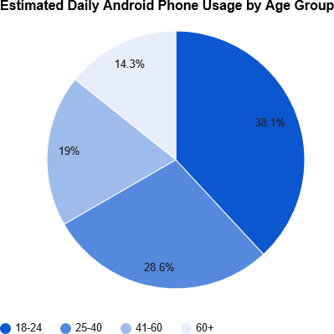
CHAPTER 2: OVERVIEW OF THE COMMUNITY
Objectives
Identify Usage Patterns: Understand how various demographic groups use Android phones for community service.
Analyze Influences: Examine how age, socioeconomic status, location, and gender affect usage.
Evaluate Impact: Assess the role of Android phones in facilitating community service, especially during the COVID-19 pandemic.
Provide Recommendations: Suggest ways for developers, marketers, and community organizations to better use Android technology to boost community service participation.
Methodology
Literature Review: Study existing research on mobile technology and community service.
Surveys and Interviews: Collect data from different user groups about their experiences and usages.
Data Analysis: Identify trends and challenges in using Android phones for community service.
Case Studies: Highlight successful community service initiatives enabled by Android phones.
Variations
Socioeconomic: Wealthier users engage in high-impact activities using advanced apps; budget- conscious users focus on grassroots volunteering using affordable apps.
Geographic: Urban users organize large-scale efforts using digital platforms; rural users access
essential services and participate in local initiatives using offline-capable apps.
Gender Differences
Men: More involved in technology-driven volunteer activities.
Women: Focus on social support and caregiving, coordinating efforts via Android phones.
COVID-19 Impact
The pandemic increased the use of remote communication apps, health monitoring tools, and
e-learning Platforms for community support and engagement
7

Slide 13
CHAPTER-3: COMMUNITY SERVICE PART
Community Segments and Usage Patterns
Youth (18-24 years)
Primary Uses:
Social Media: Extensive use of platforms like Instagram, Snapchat, and Whatsapp.
Entertainment: Streaming services such as YouTube, Netflix, and music apps like Spotify.
Gaming: Mobile gaming apps and eSports are highly popular.
Preferences: High-performance devices with advanced camera features and large, vibrant screens.
Trends: Preference for apps that support short-form content and interactive entertainment.
Young Adults (25-40 years)
Primary Uses:
Productivity: Use of apps like Microsoft Office, Google Workspace, and Slack for work- related tasks.
Communication: Email, messaging apps, and social media for personal and professional networking.
E-commerce: Online shopping and banking apps are frequently used.
Preferences: Devices with balanced performance, good battery life, and multitasking capabilities.
Trends: Growing use of fitness and health tracking apps, as well as smart home integration.
Middle-aged Adults (41-60 years)
Primary Uses:
Communication: Regular use of calls, messaging apps, and video calls to stay connected.
News and Information: Consumption of news through apps like Google News, and RSS feeds.
Productivity: Use of organizational tools and calendars to manage personal and professional life.
Preferences: Reliable devices with straightforward interfaces and robust security features.
Trends: Increasing adoption of digital payments and online shopping platforms.
Seniors Citizens (60+ years)
Primary Uses:
Communication: Emphasis on calls, SMS, and video chatting apps like Skype and WhatsApp.
News and Weather: Regular checking of news, weather forecasts, and health-related information.
Health Monitoring: Usage of apps for medication reminders and fitness tracking.
Preferences: Simple, easy-to-use interfaces with larger text and icons, and dependable performance.
Trends: Growing interest in apps that support independent living and health management.
.
8

Slide 14
ACTIVITY LOG FOR THE FIRST WEEK
Day & Date | Brief Description of the Daily Activity | Learning Outcome | Person In-charge Signature
Day –1 | Collected the information about the youth members | Known about the usage of android
Day - 2 | Met the each person in my locality. | Know about the uses of android by the members.
Day –3 | Note the each and every information. | Know about which purpose can be use.
Day –4 | Collect the information about how much time spent on android. | Understanding the time spent on android.
Day –5 | Collect the information on which the Primary purpose of android uses. | Understanding the which they can be gave high preference on android.
Day –6 | Interact with the youth people in my locality. | Noted the total information on android usage.
9

Slide 15
WEEKLY REPORT
Week – 1 (FROM 23-07-2024 to 29-07-2024)
Overview of Android Phone Usage Among Teenagers
Teenagers are among the most active users of smartphones, particularly Android devices. In recent years, around 80-90% of teens have been reported to own smartphones, with a significant portion using Android-
based devices.
Average Screen Time and Activities
Teenagers typically spend an average of 7-9 hours per day on their smartphones. This screen time is largely dominated by social media, with platforms like Instagram, Snapchat, and TikTok being the most popular.
Teens often spend 2-3 hours per day on social media, engaging in activities such as posting updates, sharing content, and messaging friends. Video streaming is another major activity, with teens dedicating 1-2 hours
daily to watching content on YouTube, Netflix, and similar platforms. Gaming also plays a significant role, with popular games like Fortnite, PUBG Mobile, and Among Us capturing 1-2 hours of their time each day.
App Usage and Preferences
The app usage patterns of teenagers reveal a strong preference for social media, messaging, and entertainment apps. Instagram, Snapchat, and TikTok are among the most frequently used apps, with teens
checking these platforms multiple times per hour. Messaging apps like WhatsApp and Facebook Messenger are also integral to their daily communication. In terms of entertainment, YouTube and Netflix are favored for video streaming, while Spotify is commonly used for music. When it comes to gaming, mobile games
are highly popular, with many teens making in-app purchases to enhance their gaming experience.
Online Behavior & Parental Controls
Teens are highly engaged on social media, frequently posting content, commenting on posts, and interacting
with peers. This high level of engagement reflects the importance of social media in their lives as a primary means of social interaction. However , parental controls are a common feature in many households,
particularly for younger teens. Approximately 30-40% of teens have some form of parental control on their devices, with screen time limits being more prevalent among those aged 13-15.
Security, Privacy, and Mental Health
While teenagers are generally aware of privacy issues related to their online activities, their understanding of the full implications is often limited. As a result, security features such as fingerprint or facial recognition,
app locks.
10

Slide 16
ACTIVITY LOG FOR THE SECOND WEEK
Day & Date | Brief Description of the Daily Activity | Learning Outcome Person | In-charge Signature
Day –1 | Collect the information about the young members. | Known about the usage of android.
Day - 2 | Met the each person in my locality. | Know about using of android by the members.
Day –3 | Note the each and every information. | Know about which purpose can be use.
Day –4 | Collecting the information about how much time spent on android. | Understanding the time spent on android.
Day –5 | Collecting the information on which primary purpose of android user | Understanding the which they can be gave high preference an android.
Day –6 | Interact with the young Adults in my locality. | Noted the total information on android usage.
11

Slide 17
WEEKLY REPORT
WEEK – 2 (From 30-07-2024 to Dt 05-08-2024)
Overview of Android Phone Usage Among Teenagers
Young adults, typically aged 18-29, are some of the most engaged users of Android smartphones. Wit near-universal smartphone ownership in this demographic, Android devices serve as essential tools for communication, work, entertainment, and social interaction. This age group is characterized by a high level of digital fluency, making them adept at using a wide range of apps and services
Device Ownership and Usage Patterns
Nearly 100% of young adults own a smartphone, with a significant portion using Android devices. On average, young adults spend 4-6 hours daily on their phones, though this can vary widely depending on individual habits and lifestyle. Their usage is often split between work-related tasks, socializing, entertainment, and personal organization.
App Usage and Preferences
Young adults use a diverse array of apps, reflecting their multifaceted needs. Social media remains a dominant activity, with platforms like Instagram, Twitter, and Facebook being widely used. However, professional networking apps like LinkedIn and productivity tools like Google Workspace are also common, particularly among those who are working or studying. Messaging apps such as WhatsApp, Telegram, and Slack are used for both personal and professional communication.
Entertainment is another major area of focus, with video streaming services like Netflix, Amazon Prime, and YouTube being particularly popular. Music streaming through apps like Spotify and Apple Music also sees significant usage. Additionally, young adults are frequent gamers, often engaging in both casual games like Candy Crush and more immersive experiences like PUBG Mobile and Genshin Impact.
Online Behavior and Social Engagement
Young adults are highly active online, using their Android devices to stay connected with friends, family, and professional networks. Social media engagement is high, with frequent posting, sharing, and interaction across multiple platforms. This group also heavily engages in content creation, whether through blogging, vlogging, or podcasting, often using their smartphones as primary tools for these activities.
Trends and Emerging Technologies
Young adults are early adopters of new technologies, and this is reflected in their use of emerging tools and platforms. Augmented reality (AR) and virtual reality (VR) apps are gaining popularity, particularly in gaming and social media. Additionally, there is growing interest in smart home integration, with many young adults using their Android devices to control smart speakers, lighting, and other connected devices. Overall, Android smartphones are integral to the lives of young adults, supporting a wide range of activities from socializing to professional development. As this demographic continues to adapt to new technologies and trends, their usage patterns are likely to evolve, reflecting broader changes in society and the digital landscape.
12

Slide 18
ACTIVITY LOG FOR THE THIRD WEEK
Day & Date | Brief Description of the Daily Activity | Learning Outcome | Person Incharge Signature
Day –1 | Collected the information about the adult. | Known about the usage of the Android.
Day - 2 | Met the each person in my locality. | Know about the uses of android by the members.
Day –3 | Note the each and every information. | Know about the which purpose occur.
Day –4 | Collect the information about how much time spent on android. | Understanding the time spent on android.
Day –5 | Collect the information on which the primary purpose of android uses. | Understanding the which they can be gave high preference on android.
Day –6 | Interact with the adults in my locality. | Noted the total information on android usage.
13

Slide 19
WEEKLY REPORT
WEEK-3 (FROM 06-08-2024 TO 12-08-2024)
Overview of Android Phone Usage Among Adults
Adults aged 30-59 represent a diverse group with varied Android smartphone usage patterns. For this demographic, smartphones are essential tools that support both professional responsibilities
and personal life. With widespread smartphone ownership, Android devices are used extensively for communication, work, entertainment, and managing daily activities.
Online Behavior and Social Engagement
Adults are active users of social media, though their engagement tends to be more focused on
maintaining connections with family, friends, and professional networks. Platforms like Facebook, LinkedIn, and Instagram are commonly used, though the level of engagement is often more measured compared to younger demographics. Many adults also engage in content consumption related to news, health, and lifestyle, using apps like Flipboard, Google News, and specialized apps for health and wellness.
Security, Privacy, and Health Concerns
This age group tends to be more conscious of security and privacy issues. Many adults use
advanced security features like biometric authentication, password managers, and encrypted messaging apps to protect their personal and professional data. There is also an increasing awareness of the health impacts of prolonged smartphone use, such as eye strain, sleep disruption, and the effects of screen time on mental well-being. As a result, some adults actively manage their digital wellness by setting screen time limits, using blue light filters, and engaging in digital detox practices.
Trends in Usage and Emerging Technologies
Adults in this demographic are increasingly adopting emerging technologies that enhance convenience and productivity. This includes the use of smart home devices, which are often
controlled via Android smartphones, such as smart thermostats, lighting, and security systems. Additionally, many adults are exploring the benefits of wearable technology, integrating it with their smartphones to monitor health metrics, fitness activities, and even stress levels.
14

Slide 20
ACTIVITY LOG FOR THE FOURTH WEEK
Day & Date | Brief Description of the Daily Activity | Learning Outcome | Person In- charge Signature
Day –1 | Collected the information about the Senior Citizens members | Known about the usage of Android.
Day - 2 | Met the each person in my locality. | Know about the uses of Android by the members.
Day –3 | Note the each and every information . | Know about which purpose can be use
Day –4 | Collect the information about how much time spent on android | Understanding the time spent on Android.
Day –5 | Collecting the information on which the primary purpose of android uses. | Understanding the which they can be gave high preference on android.
Day –6 | Interact with the senior citizens in my locality | Noted the total information on android usage
15

Slide 21
WEEKLY REPORT
WEEK-4 (FROM 13-08-2024 TO 19-08-2024)
Overview of Android Phone Usage Among Senior Citizens
Senior citizens, typically aged 60 and above, are increasingly adopting Android smartphones, though their usage patterns differ from younger demographics. While smartphone penetration in this group has grown significantly in recent years, their usage tends to focus on essential functions such as communication, health management, and staying informed.
Device Ownership and Usage Patterns
Smartphone ownership among senior citizens has seen a steady increase, with many opting for Android devices due to their affordability and user-friendly options like larger screens and simplified interfaces. On average, seniors spend about 1-3 hours per day on their smartphones. Their usage is generally more focused and intentional, with less time spent on entertainment or social media compared to younger age groups.
Online Behavior and Digital Literacy
Digital literacy among senior citizens varies widely. Some are very comfortable using smartphones and apps, while others may struggle with more advanced features. Many seniors prefer simpler interfaces and larger text sizes, and they often benefit from devices with accessibility features like voice commands, magnification, and hearing aid compatibility.
While social media use is less common among seniors, those who do engage typically use it to maintain social connections and stay informed. Email remains a popular method of communication, particularly for those who are less familiar with instant messaging apps.
Security, Privacy, and Health Concerns
Senior citizens are generally cautious about online security and privacy. They are aware of the risks of scams and phishing attacks, and many rely on family members to help manage these concerns. Seniors often use antivirus software and are increasingly adopting practices like two-factor authentication to secure their online accounts.
Health concerns also influence their smartphone usage. Many seniors are mindful of limiting screen time to avoid eye strain or exacerbating any existing health conditions. They also use their devices to monitor health metrics, stay active with guided exercise routines, and maintain social contact to combat loneliness.
16

Slide 22
ACTIVITY LOG FOR THE FIFTH WEEK
Date & Day | Briefly Description of the Daily Activity | Learning Outcome | Person In-charge Signature
Day-1 | Collect the data about which purpose the phones can be use | Mainly phones can be using in my locality communication , Web browsing & Entertainment
Day-2 | Awareness on using phone for Senior citizens | They can stay connected with family and friends via calls, messaging,Video chats.
Day-3 | Awareness of Right Apps Usage | By recognizing the importance of app security, users will choose apps with strong protective features to safeguard personal information.
Day-4 | Awareness on Social Media Engagement | They will understand the importance of verifying information before sharing, promoting digital literacy and combating mis information.
Day-5 | Public Announcement & Awareness in Gudur. | Understand the impact of initial engagement efforts on public interest and participation.
Day-6 | Taking the feedback about the usage of the phones | Encourage the audience to reflect on their own phone habits and adopt a balanced approach to technology.
17
DEPARTMENT OF COMPUTER SCIENCE AND ENGINEERING (DATA SCIENCE)

Slide 23
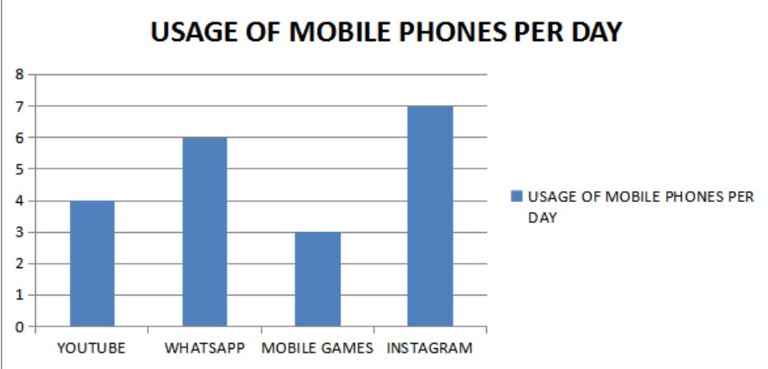
WEEKLY REPORT
WEEK- 5 ( FROM 20-08-2024 TO 26-08-2024)
USAGE OF PHONES PER DAY
Average Daily Usage:
Many reports suggest that the average adult spends about 3 to 4 hours a day on their smartphones. However, this can be higher for younger users, with teens often exceeding 7 hours daily.
Social Media Engagement:
Users typically spend about 30-40% of their phone time on social media platforms like Instagram, TikTok, and Facebook.
Whatsapp :
* Users spend an average of 38 minutes per day on WhatsApp.
* Over 2 billion users worldwide, making it one of the most popular messaging apps.
Gaming Apps :
* Casual gamers spend about 30 minutes to 2 hours daily, while more dedicated gamers can spend several hours.
* Mobile gaming generates billions in revenue, with popular titles attracting millions of daily active users (e.g., PUBG, Candy Crush).
Instagram :
* Users average about 30 minutes to over an hour daily on Instagram.
* Around 1.5 billion monthly active users; it’s particularly popular among younger demographics.
Youtube :
* Users typically spend about 30 minutes to over an hour on YouTube daily.
* More than 1 billion hours of videos are watched in youtube.
18

Slide 24
ACTIVITY LOG FOR THE SIXTH WEEK
Day & Date | Brief Description of the Daily Activity | Learning Outcome | Person In-Charge Signature
Day-1 | Collect the data about the Male’s can be screen usage of the phone. | Men tend to spend significant time on their phones daily, with studies indicating that male users might average around 3 to 5 hours per day, depending on their age group and life style.
Day-2 | Collect the data about the Female’s can be screen usage of the phone. | Women tend to spend an average of about 3 to 5 hours on their phones daily, with variations depending on age, lifestyle, and personal preferences.
Day-3 | Conduct a survey on the phones usage by male’s in my locality. | To visualize data related to communication, entertainment, shopping, productivity, health, and privacy.
Day-4 | Conduct a survey on the phones usage by female’s in my locality. | To visualize data related to communication, entertainment, shopping, productivity, health, and privacy.
Day-5 | Collect the data in male’s which the purpose can be usage of phone. | Phone usage is characterized by a blend of communication, entertainment, productivity, and shopping activities.
Day-6 | Collect the data in female’s which the purpose can be usage of phone. | They frequently engage with messaging apps such as WhatsApp and Facebook Messenger to stay connected with friends and family.
19

Slide 25
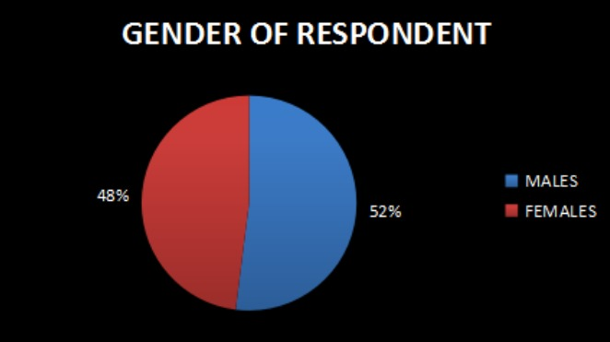
WEEKLY REPORT
WEEK – 6 (FROM 27-08-2024 TO 02-09-2024)
PHONE USAGE TRENDS BY GENDER
Overall Screen Time:
Females: Often spend more time on their phones, averaging about 4-5 hours daily.
Males: Typically spend around 3-4 hours daily, with variations based on age and
interests.
Social Media :
Females: More engaged with platforms like Instagram, Facebook, and Pinterest. They
tend to spend more time posting, commenting, and connecting.
Males: Frequently use Twitter, Reddit, and YouTube, often engaging in discussions and
consuming content related to gaming and technology.
Shopping & E-Commerce :
Female : More likely to use their phones for Online shopping particularly in fashion and
beauty.
Male : Also engaging Online Shopping , Often focusing on Electronic and Gaming
product.
Video Content :
Females : More likely to watch lifestyle, beauty, and educational videos on platforms like
Youtube.
Males: Often watch gaming streams , tech reviews and sports content , contributing to higher
engagement in those areas.
20

Slide 26
ACTIVITY LOG FOR THE SEVENTH WEEK
Day & Date | Breif description of the Daily Activity | Learning Outcomes | Person In-Charge Signature
Day-1 | Collect the public information in my locality | Known about the usage of phone with high time
Day-2 | Met the each person in my locality. | Know about using of android by the members.
Day-3 | Note the each and every information. | Know about which purpose can be use.
Day-4 | Explain about the impact of Digital addiction | Digital awareness is about being mindful and intentional in how we engage with technology. It is essential for maintaining a healthy balance between online activities and offline life
Day-5 | Conduct the survey on the digital awareness in my locality | They would help you understand how digital addiction affects various groups, the awareness of digital rehab, and the effectiveness of digital detox strategies.
Day-6 | Explain about demerits of the Phone usage | Phone usage varies widely based on demographics like age, occupation, and lifestyle. Children and teens are typically heavy consumers of entertainment etc.
21
DEPARTMENT OF COMPUTER SCIENCE AND ENGINEERING (DATA SCIENCE

Slide 27
WEEKLY REPORT
WEEK- 7 (FROM 03-09-2024 TO 09-09-2024)
The Impact of Digital Addiction
The characterized y excessive and compulsive use of digital devices, has become to the growing concern in today's technology-driven world. The negative consequences of this addiction can be manifest in various aspects of life, including physical health, mental well-being, relationships, and be the productivity.
Physical Health Impacts :
Sedentary Lifestyle: Excessive screen time often leads to a sedentary lifestyle, increasing the risk of obesity, heart disease, and other chronic health conditions.
Sleep Disorders: The blue light emitted by screens can disrupt sleep patterns, leading to insomnia, fatigue, and impaired cognitive function.
Eye Strain: Prolonged exposure to screens can cause eye strain, headaches, and blurred vision.
Repetitive Strain Injuries: Exc Digital Addiction
Digital addiction, often Repetitive Strain essive typing or scrolling can contribute to repetitive
strain injuries like carpal tunnel syndrome.
Mental Health acts :
Anxiety and Depression: Digital addiction can exacerbate feelings of anxiety and depression, particularly when individuals compare themselves to idealized online person.
Social Isolation: Excessive screen time can lead to social isolation and reduced face-to-face interactions, impacting emotional well-being.
FOMO (Fear of Missing Out): The constant stream of updates on social media can create a sense of FOMO, leading to anxiety and dissatisfaction.
Attention Deficit Hyperactivity Disorder (ADHD): Excessive screen time has been linked to increased symptoms of ADHD, such as difficulty concentrating and impulsivity.
Relationship Impacts :
Strained Relationships: Digital addiction can strain relationships with family and friends, as individuals prioritize screen time over face-to-face interactions.
Cyberbullying: The anonymity of the internet can contribute to cyberbullying, negatively impacting mental health and social relationships.
22

Slide 28
ACTIVITY LOG FOR THE EIGHTH WEEK
Day & Date | Breif Description of the Daily Activity | Learning Outcome | Person In-Charge Signature
Day-1 | Collect the public information in my locality | Known about the Sustainity health habits.
Day-2 | Met the each person in my locality. | Know about the dis -advantages of using mobiles
Day-3 | Note the each and every information. | Most people can be use For education commun -ication and entertain -ment.
Day-4 | Note about the Mental wellness and digital detox | Educate the community about the impact of excessive screen time on mental health, and how to establish healthier digital habits
Day-5 | To told about the Reducing screen distraction | Most people can using High screen time
Day-6 | To told about the enhancing the real life social connection | Mental health professionals or community leaders about the importance of face-to-face interactions and the negative effects of digital isolation.
23

Slide 29
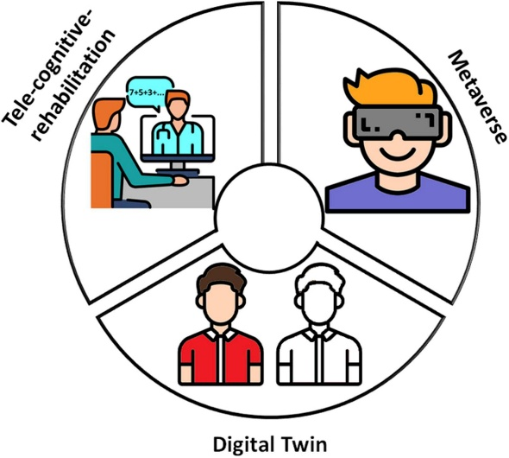
WEEKLY REPORT
WEEK-8 (FROM 10-09-2024 TO 16-09-2024)
SUSTAINITY HEALTH HABITS
1.Set Clear Boundaries
Screen Time Limits: Establish daily limits for phone use, focusing on reducing overall screen time. Use built-in tools or apps to track usage.
Device-Free Zones: Create areas in your home (like the bedroom or dining room) where phone use is not allowed to encourage offline interactions.
2. Mindful Usage
Purposeful Engagement: Before picking up your phone, ask yourself why you’re doing it. Aim to use your device with intention rather than habit.
Scheduled Breaks: Incorporate regular breaks from screens throughout the day. Use techniques like the Pomodoro Technique to structure work and rest intervals.
3. Digital Detox
Regular Detox Periods: Plan regular digital detoxes, whether for a day, weekend, or longer, to help reset your relationship with technology.
Offline Activities: Engage in offline hobbies, such as reading, exercising, or spending time with friends and family, during detox periods.
4. Use Technology Wisely
Health Apps: Utilize apps designed to promote well-being, like meditation apps (e.g., Headspace, Calm) or fitness trackers that encourage physical activity.
Notifications Management: Turn off non-essential notifications to minimize distractions and interruptions throughout the day.
5. Build Supportive Habits
Accountability Partners: Share your goals with friends or family members who can help keep you accountable and motivated.
Group Activities: Participate in group activities or challenges that promote healthy habits, such as exercise classes or book clubs that encourage screen-free time.
24

Slide 30
CHAPTER 5: Outcomes Description
Details of the Android phone usage by different people. Attach the questionnaire prepared for the survey.
To er understand the usage of Android phones among different demographics, we have designed a comprehensive questionnaire. This survey begins with a demographic section to gather basic information about the responbettdents. Participants will be asked to provide their age, gender, location, and occupation. This information helps contextualize the data and analyze trends based on different groups.
In the next section, we delve into specific Android phone usage. Respondents will identify the brand of their current Android device, share how long they have been using Android phones, and indicate their daily usage in hours. Additionally, they will specify their primary uses for the phone, such as social media, communication, entertainment, navigation, or work-related tasks. We also ask participants to name their most frequently used apps to understand popular choices in the Android ecosystem.
The survey continues with preferences and behaviors surrounding Android phones. Participants will rate their satisfaction with their current device and rank the most important features when selecting a phone, such as battery life, camera quality, and processing speed. We will also inquire about the frequency of the software updates and the respondents' feelings regarding ads on their devices.
Finally, the questionnaire includes open-ended questions that invite participants to suggest improvements they would like to see in Android phones and share any additional comments or feedback. This qualitative data will provide deeper insights into user experiences and expectations.
25

Slide 31
Describe the problems you have identified in the community
1. Digital Divide
Many individuals in the community have varying levels of access to technology. Some may not afford the latest devices or reliable internet, leading to disparities in usage and opportunities for learning or connection.
2. Overuse and Addiction
Excessive use of smartphones can lead to addiction, affecting mental health, productivity, and social interactions. Many users report spending hours on social media or gaming, often at the expense of real-world relationships and responsibilities.
3. Privacy and Security Concerns
Users often lack awareness regarding privacy settings and the implications of data sharing. Many people may not use strong passwords or enable security features, making them vulnerable to hacking and data breaches.
4. Technical Issues and Frustration
Frequent software updates, app crashes, and battery issues can frustrate users. Some may struggle with troubleshooting these problems, leading to dissatisfaction with their devices.
5. Ad Overload
Users often express frustration with intrusive advertisements, which can disrupt their experience. This can lead to a negative perception of certain apps or services, pushing users to seek alternatives.
6. Limited Customization and Personalization
Some users feel that their Android devices do not offer enough options for personalization, leading to dissatisfaction with the user experience. This can impact how engaged they feel with their devices.
7. Fragmentation of Android Devices
The wide variety of Android devices and versions can lead to inconsistencies in app performance and user experience. This fragmentation makes it difficult for developers to ensure compatibility and optimal performance across all devices.
8. Environmental Concerns
As the community increasingly relies on technology, concerns about electronic waste and the environmental impact of discarded devices have become prominent. Users may feel conflicted about upgrading to newer models due to sustainability issues.
26

Slide 32
Short-term and long term action plan for possible solutions for the problems identified in digital or phone usage
1. Monitor how often you're using your phone
Apps like QualityTime and Moment can be used to monitor your phone usage. They will tell you how much time you spent using your cell phone on any given day.
Once you get a sense of how much you use your phone,decide how much you want to cut back. For example, say you use your phone for three hours a day and want to cut that in half. You can strive for only 90 minutes of phone usage in the coming days.
You can even set your phone timer to help limit your sessions.
2. Turn off notifications
Most new apps ask you if you want to allow notifications when you first install them. You should get into the habit of saying "No.“
On your existing apps, turn off notifications. It will be easier to avoid checking Facebook if you don't get a notification telling you there's a new message in your inbox.
3.Turn your phone off during certain hours each day.
It can be particularly helpful to do this right before bed. This will help you disengage and unwind for sleep.
Check your phone settings and see if you can program your phone to shut off after certain number of hours
4.Have specific guidelines for phone usage
Make a family rule about phone use. For example, you might make that everyone in the family has to power down their cell phones for the evening at a designated time, such as 7pm. You might even have everyone drop their phones into a basket for the night.
27

Slide 33
Description of the Community awareness programme/s conducted w.r.t the
problems and their outcomes.
The awareness program on digital rehabilitation aimed to educate the community about the importance of managing smartphone usage and fostering healthier relationships with technology. This initiative included a series of workshops, seminars, and interactive activities designed to engage participants and promote digital well-being.
The program kicked off with a community seminar featuring experts in psychology and digital wellness, who discussed the impacts of excessive screen time on mental health and overall well-being. Participants learned about issues such as digital addiction, anxiety, and the effects of social media on the self-esteem. These discussions were complemented by practical strategies for reducing screen time and implementing mindful technology use.
Workshops included activities like the Digital Detox Challenge, where participants committed to unplugging from their devices for a set period. They documented their experiences, reflecting on the benefits of engaging in offline activities, such as reading, exercising, and spending time with family and friends. Mindfulness sessions, including yoga and meditation, were incorporated to help participants develop skills for managing stress and improving focus.
Educational materials were distributed throughout the program, providing resources on setting screen time limits, creating tech-free zones at home, and understanding privacy settings. Special in the sessions were organized for parents and teens, fostering open discussions about the pressures of social media and promoting healthy communication strategies.
The outcomes of the program were promising. Participants reported increased awareness of their technology habits and a commitment to making changes, such as reducing screen time and prioritizing face-to-face interactions. Many noted improvements in their mental health, including reduced stress and anxiety. The program also helped strengthen community bonds, as participants shared experiences and supported one another in their journeys toward digital well-being.
Participants noted improvements in their mental well-being, including reduced anxiety and stress levels. Engaging in mindfulness activities and community events fostered a sense of connection and support.
28

Slide 34
Report of the mini-project work done in the related subject w.r.t the habitation/village.
The main purpose of the internship is to help the people in my village and enhance awareness about the importance of the “ DIGITAL REHABITATION CENTERS “.
Teenagers(13-19)
This age people can be spend 7-9 hours daily on their devices, focusing on social media, streaming, and gaming, with apps like Instagram and TikTok being particularly popular. This heavy usage comes with growing concerns about mental health, though parental controls help manage their screen time.
Young Adults(18-29)
This age people can be use their phones for a mix of work and leisure, averaging 4-6 hours daily. They balance productivity tools, social media, and entertainment, with a strong focus on security and emerging technologies like AR/VR. Their usage reflects a blend of professional and personal needs, driven by their active lifestyle.
Adults(30-59)
This age people can spend 3-5 hours daily on their smartphones, utilizing them for communication, work, and managing daily activities. Their focus is on productivity, financial management, and digital wellness, with an increasing integration of smart home devices and health apps into their routines.
Senior Citizens(60+)
This age people can use their Android phones for communication and health management, averaging 1-3 hours daily. They prefer simple interfaces and safety features, and are increasingly adopting voice assistants and telehealth services to enhance their connectivity and well-being.
29

Slide 35
CHAPTER 6: Recommendations and Conclusions of the Mini Project
* Keep distance – Hold the cell phone away from body to the extent possible.
* Use a headset (wired or Bluetooth) to keep the handset away from the head.
* Don’t press the phone handset against your head. Radio Frequency (RF) energy is
inversly propotional to the square of the distance from the source.
* Limit the length of the mobiles.
* Use text as compared to voice whenever possible.
* When your phone is ON , don’t carry it in chest / breadst or pants pocket when a mobile
is ON, it automatically transmit at high power.
* Reduce mobile phone use by children as a younger person will have a longer lifetime
exposure to radiation from cell phone.
CONCLUSION
The usage of mobile phones is depending on you, how you use your mobile phones.You can prevent yourself from these bad effects of using mobile phones. By limiting your usage of mobile phones
. This is your responsibility to know from all the good and bad effects of using mobile phones and prevent yourself and your loved ones from their bad effects.
Everything is depending on you that how you use mobile phonesif you use them in a good way and limit then you can prevent yourself from its bad effects.And if you use it in a bad way then its results will be obviously bad.
My responsibility and the basic aim of this article is toinform all the people about the bad effects of excessive usage of mobile
phones.Now it’s y
30

Slide 36
Student Self-Evaluation for the Community Internship Report
Student Name:ALAMPOOR THARUN SINGH
Registration No: 22G21A3202
Period of CSI: 8 WEEKS From: 23-07-2024 To: 17-09-2024
Date of Evaluation: 04-10-2024
Name of the Person in charge: Dr. S.V.PADMAVATHI DEVI (Ph.D)
Address with mobile number: BADVEL KADAPA (DIST)
ph.no.:7702173084
Please rate your performance in the following areas: Rating Scale: 1 is lowest and 5 is highest rank
1) Oral communication 1 2 3 4 5
2) Written Communication 1 2 3 4 5
3) Proactiveness 1 2 3 4 5
4) Interaction ability with community 1 2 3 4 5
5) Positive Attitude 1 2 3 4 5
6) Self-Confidence 1 2 3 4 5
7) Ability to learn 1 2 3 4 5
8) Work Plan and Organization 1 2 3 4 5
9) Professionalism 1 2 3 4 5
10) Creativity 1 2 3 4 5
11) Quality of work Done 1 2 3 4 5
12) Time Management 1 2 3 4 5
13) Understanding the community 1 2 3 4 5
14) Achievement of Desired Outcomes 1 2 3 4 5
Date:
Signature of the Student
31

Slide 37
Student Evaluation by the Person in-charge in the Community/Habitation
Student Name: ALAMPOOR THARUN SINGH
Registration No: 22G21A3202
Period of CSI: 8 WEEKS From: 23-07-2024 To 17-09-2024 Date of Evaluation: 04-10-2024
Name of the Person in charge: Dr.S.V. PADMAVATHI DEVI (Ph.d)
Address with mobile no.: Sullurpeta
Ph No: 9249501196
Please rate the student’s performance in the following areas: Rating Scale : 1 is lowest and 5 is highest rank
1) Oral communication 1 2 3 4 5
1
2) Written communication 1 2 3 4 5
3)Proactiveness 1 2 3 4 5
4) Interaction ability with community 1 2 3 4 5
5) Positive Attitude 1 2 3 4 5
6) Self-Confidence 1 2 3 4 5
7) Ability to learn 1 2 3 4 5
8) Work Plan and organization 1 2 3 4 5
9) Professionalism 1 2 3 4 5
10) Creativity 1 2 3 4 5
12) Time Management 1 2 3 4 5
11) Quality of work done 1 2 3 4 5
13) Understanding the Community 1 2 3 4 5
14) Achievement of Desired Outcomes 1 2 3 4 5
15) Overall Performance 1 2 3 4 5
Date:
Signature of the Supervisor:
32

Slide 38
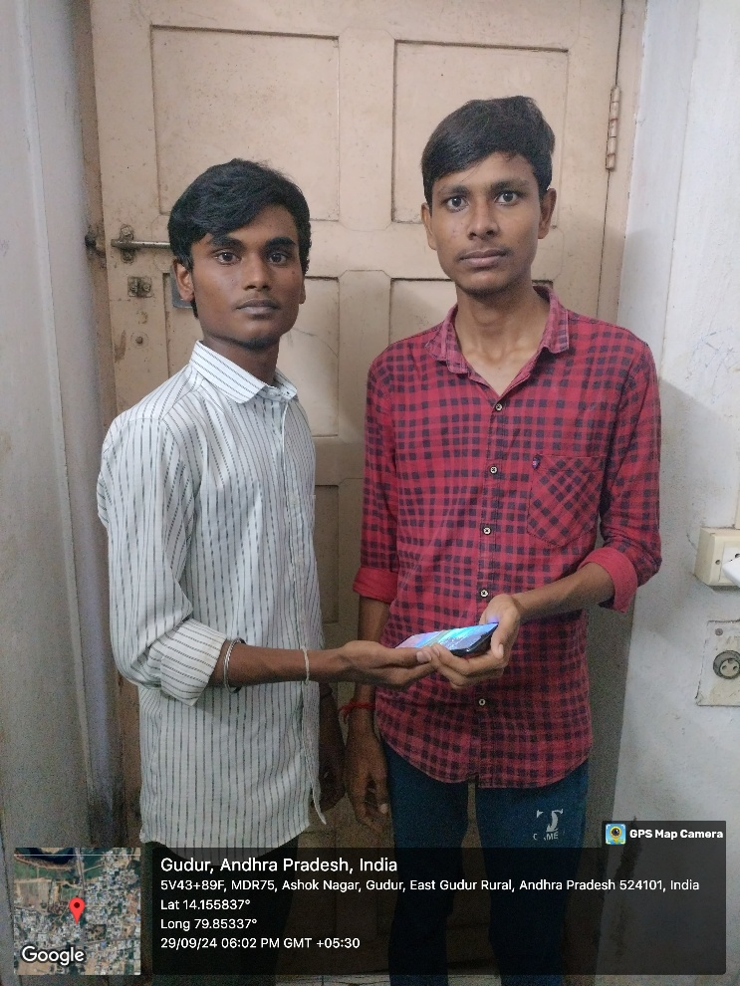
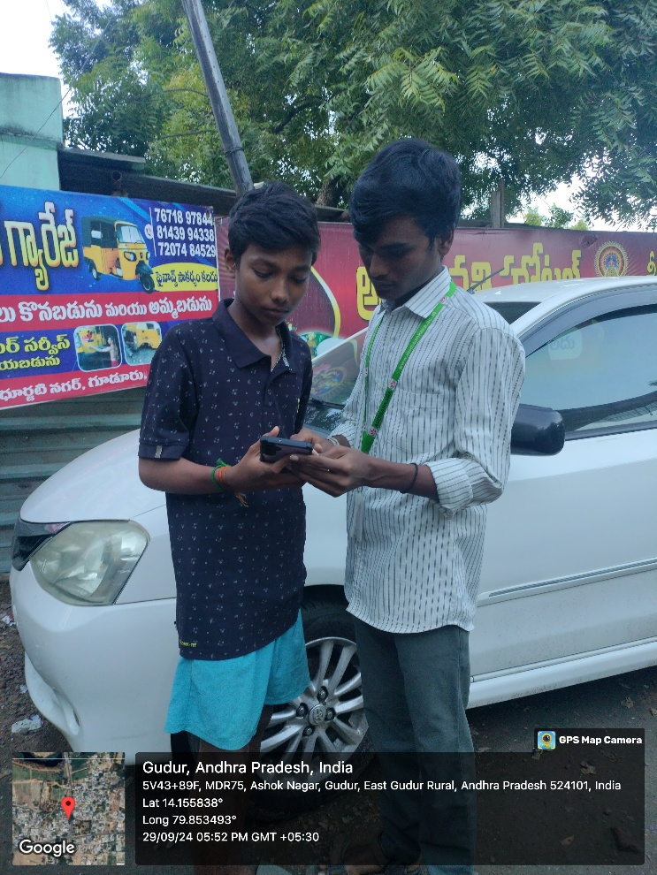
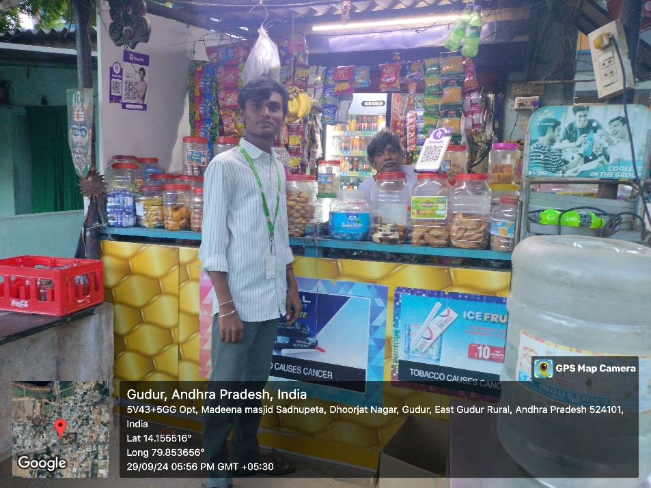
PHOTOS
33
DEPARTMENT OF COMPUTER SCIENCE AND ENGINEERING (DATA SCIENCE)

Slide 39
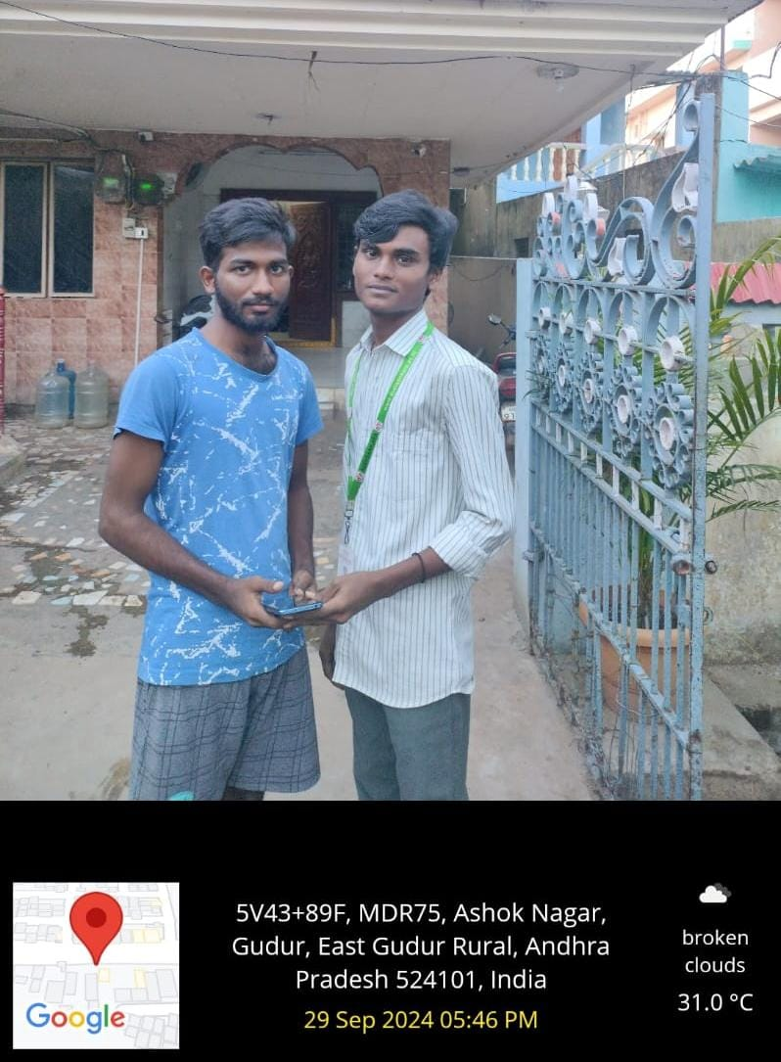
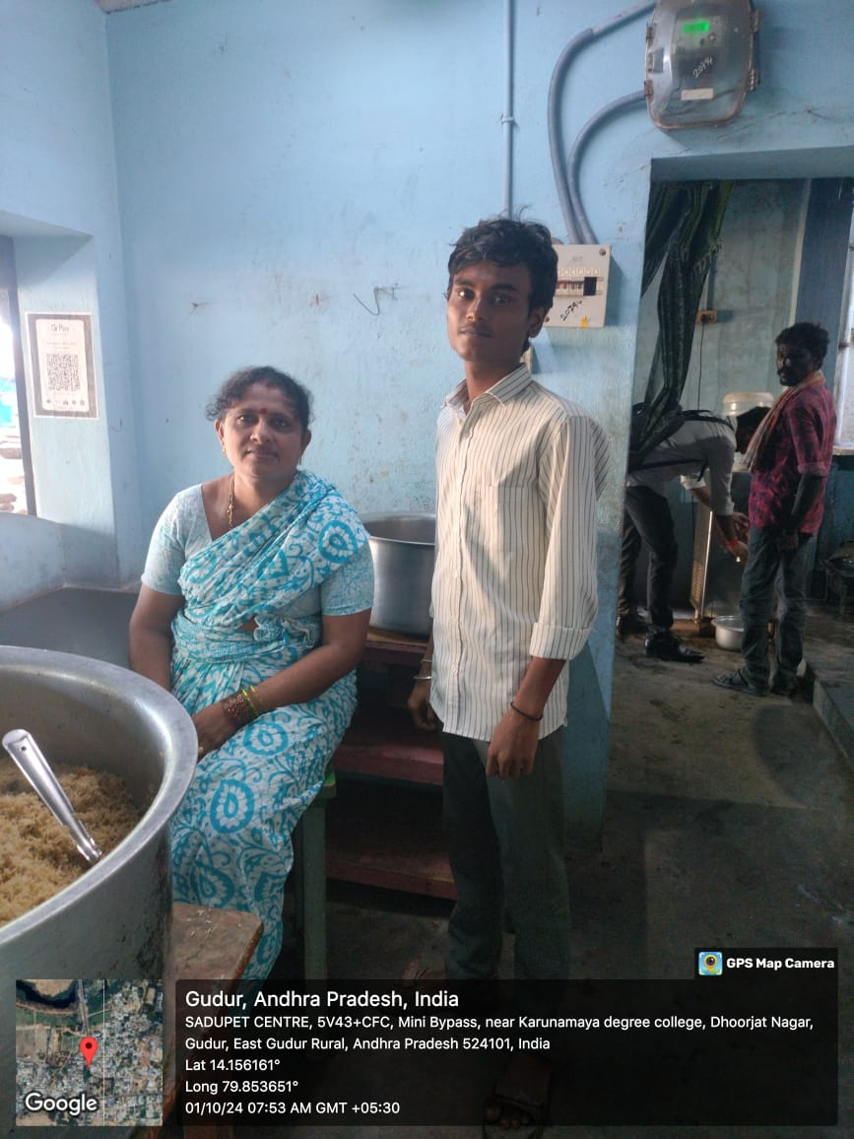
34
DEPARTMENT OF COMPUTER SCIENCE AND ENGINEERING (DATA SCIENCE)

